Slide 1

Boundary Layer Separation over Porous Substrates
Lina Salsabila Youssfi, Dr. Gokul Pathikonda
Arizona State University
Arizona Space Grant Symposium
Special thanks to Krishna Kompally for help with PIV experiments
The material contained in this document is based upon work supported by a National Aeronautics and Space Administration (NASA) cooperative agreement 80NSSC20M0041. Any opinions, findings, conclusions or recommendations expressed in this material are those of the author and do not necessarily reflect the views of NASA. This work was supported through a NASA grant awarded to the Arizona/NASA Space Grant Consortium

Slide 2
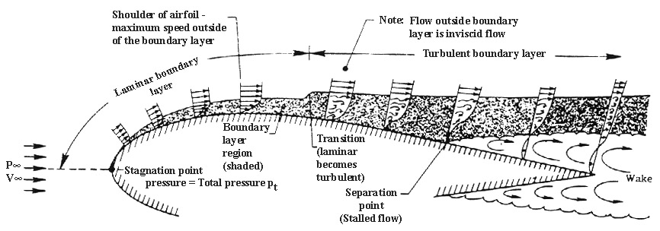

Research Objective
What is a boundary layer and what does it dictate?
Why does boundary layer separation occur and why is there a need to control it?
Notes:
bL occur in nature
"Our study aims to understand how geometry-induced separation depends on surface characteristics, particularly the role of surface-induced inhomogeneities in the boundary layer.”
"We also explore whether we can leverage this understanding in order tto delay separation "

Slide 3
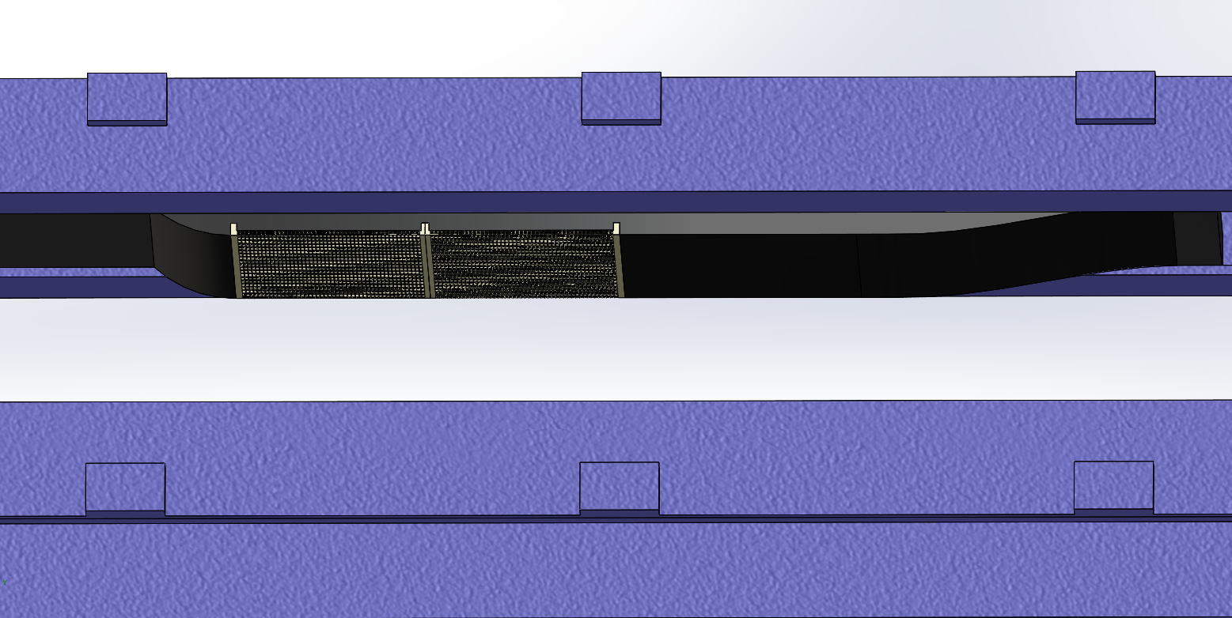
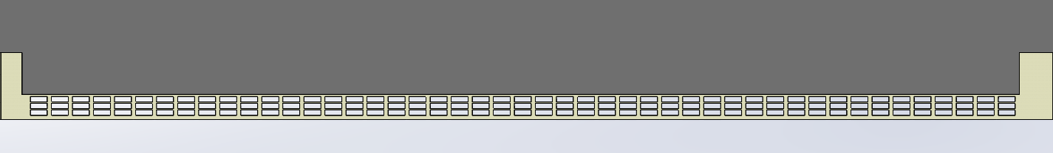
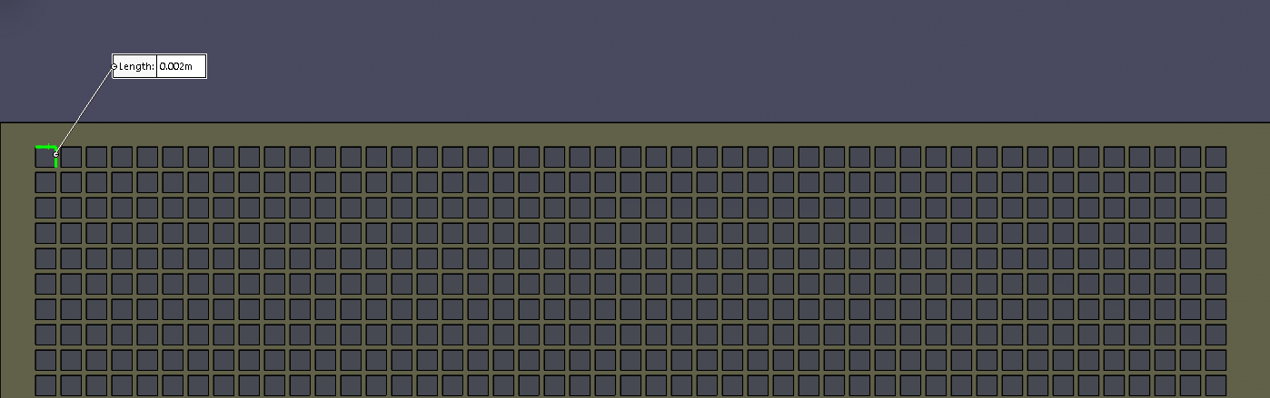
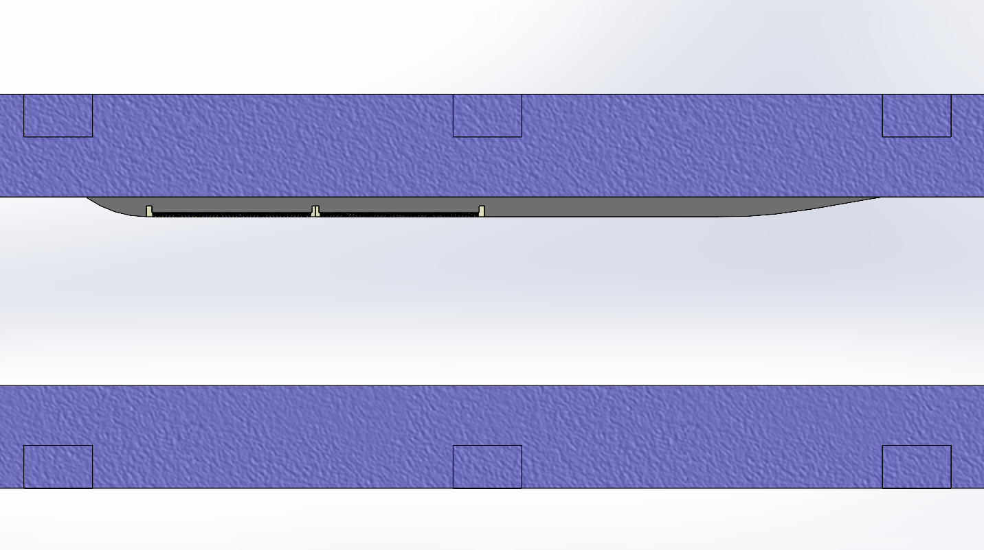
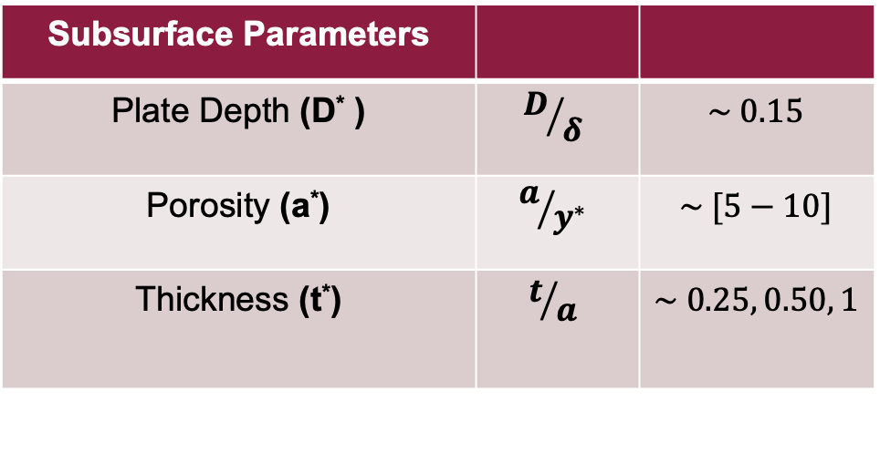
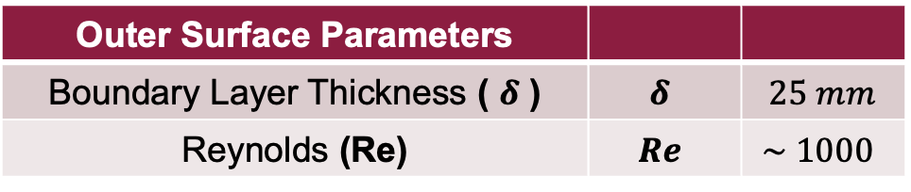
Porous Plate Geometry
Subsurface Parameters
Plate Depth (D* ) | $$D/δ$$ | $$\sim 0.15$$
Porosity (a*) | $$a/{y^{∗}}$$ | $$\sim [5−10]$$
Thickness (t*) | $$t/a$$ | $$\sim 0.25, 0.50, 1$$
Outer Surface Parameters
Boundary Layer Thickness ( $δ$ ) | $$δ$$ | $$25 mm$$
Reynolds (Re) | $$Re$$ | $$\sim 1000$$
Notes:
For our current experiments

Slide 4
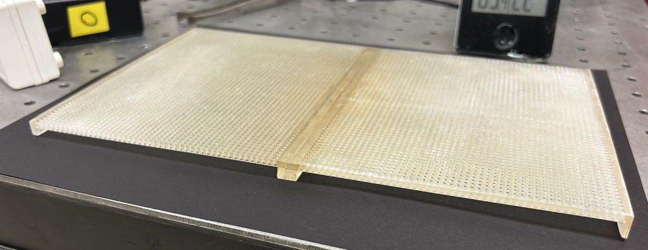
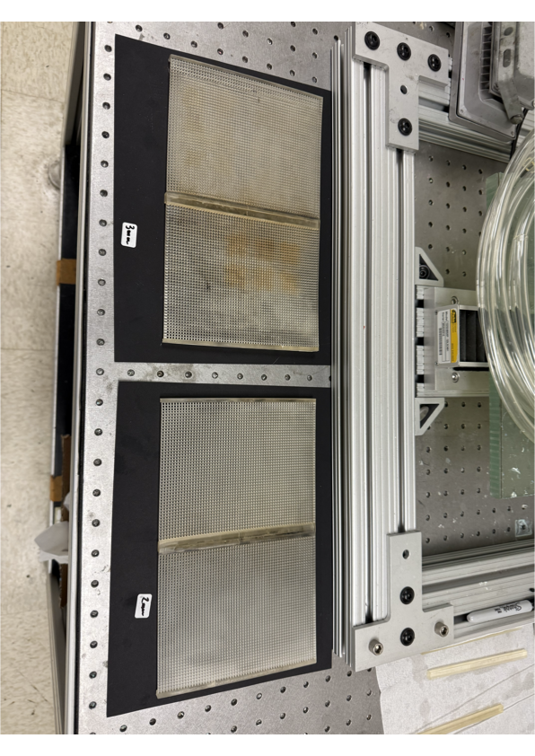
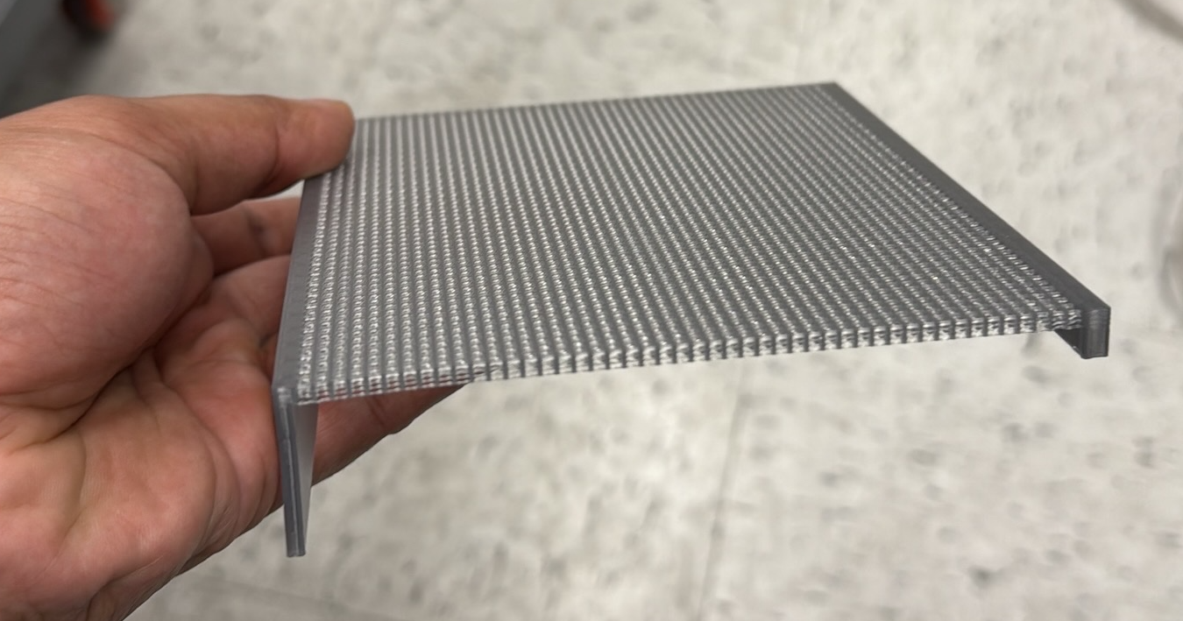
Porous Plate Manufacturing
Notes:
For our current experiments

Slide 5
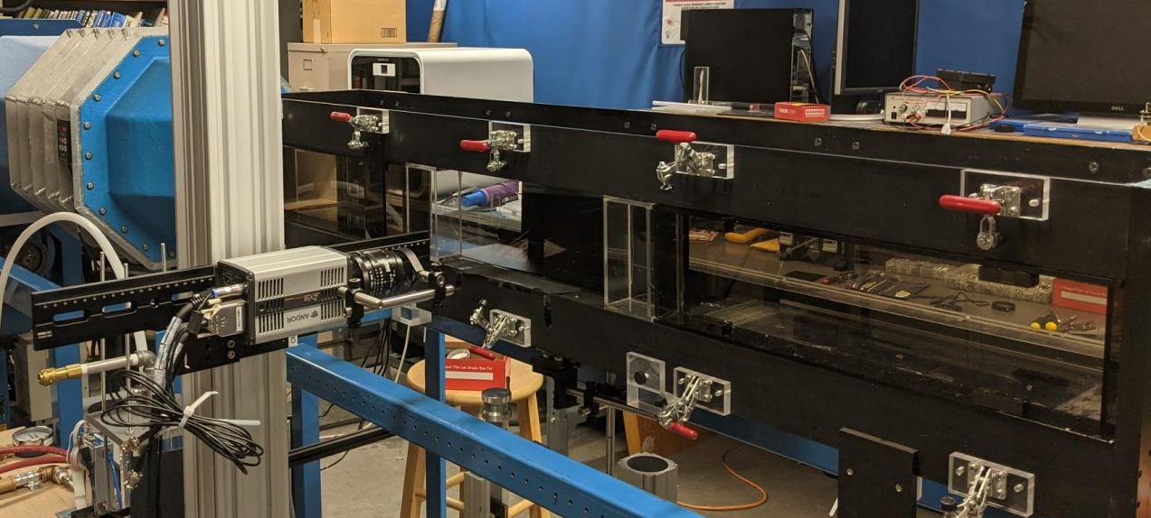
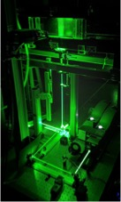
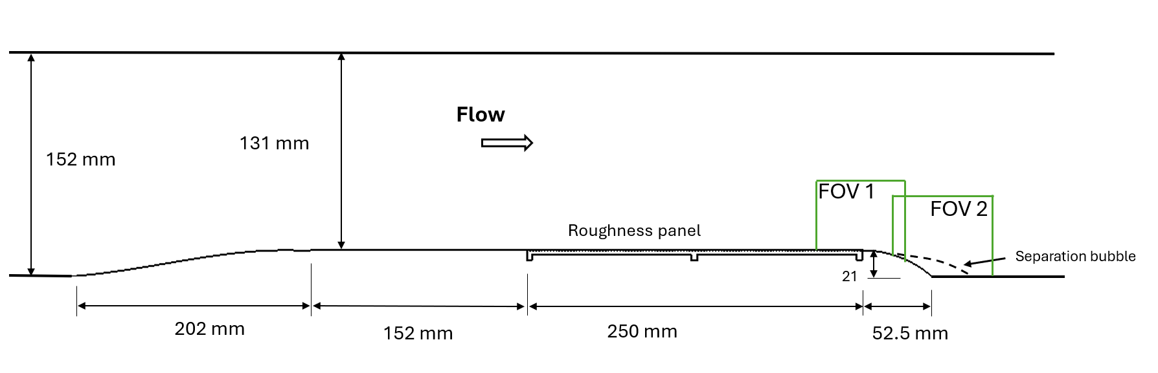



Experimental Setup
Quantel Q-Smart Nd:YAG laser 380 mJ/pulse @ 532
4 MP Phantom V641 camera
Laskin nozzle filled with olive oil used as seeder
The BL develops over SW transitions to a porous plate
Total FOV : ~1.5𝜹 x 6𝜹
Incident boundary layer
$$y$$
$$x$$
$$z$$

Slide 6
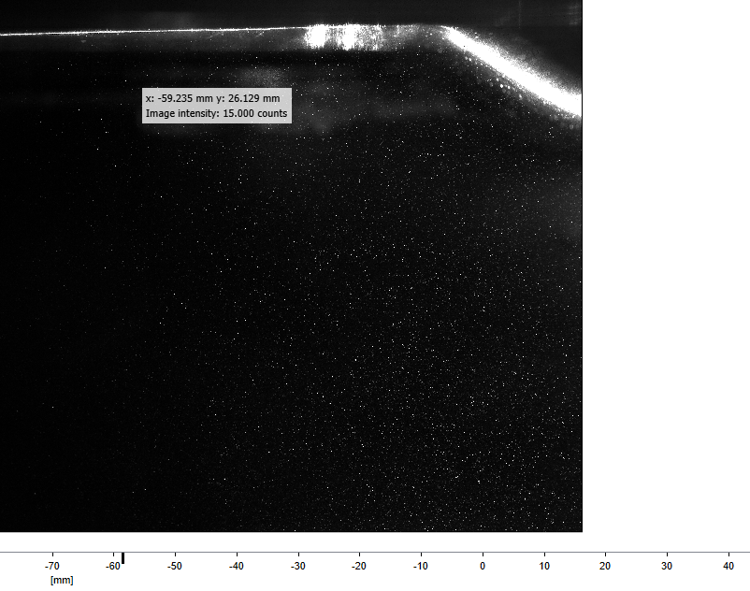
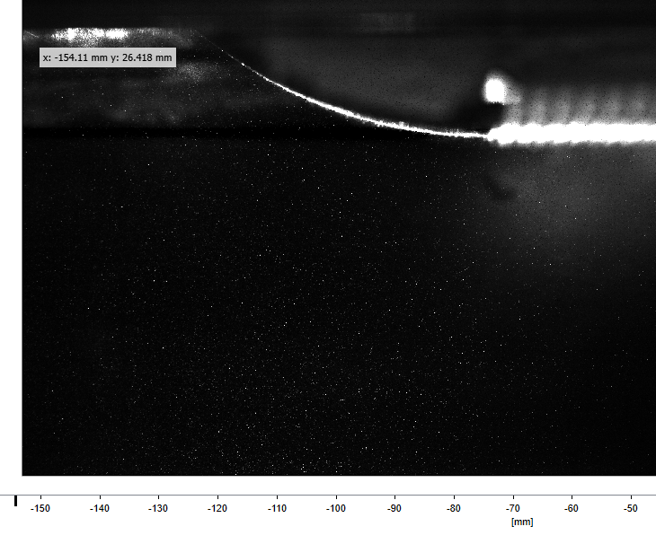
Particle Image Velocimetry

Slide 7
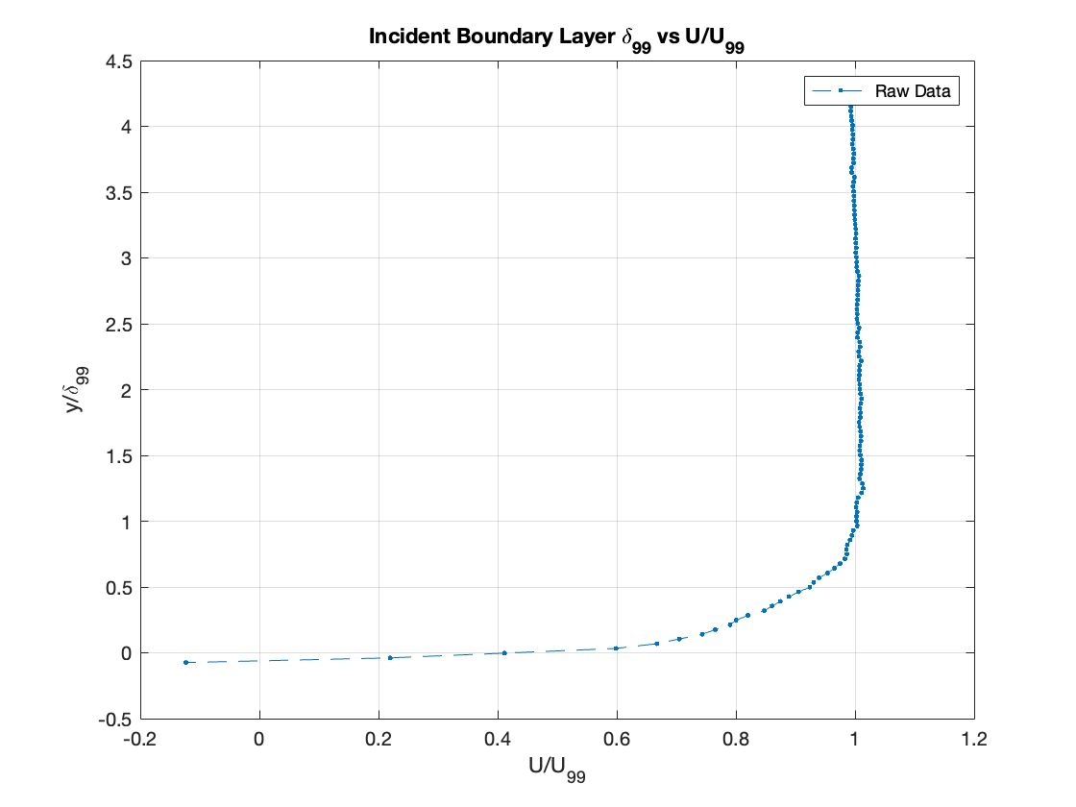
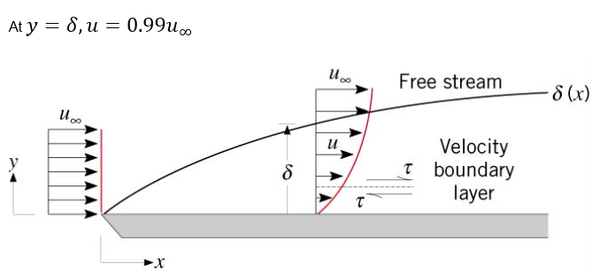
Incident Boundary Layer
Incident boundary layer

Slide 8
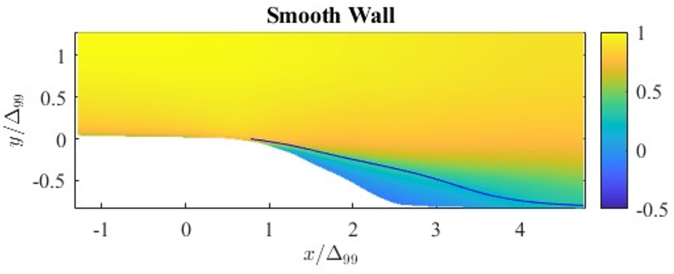
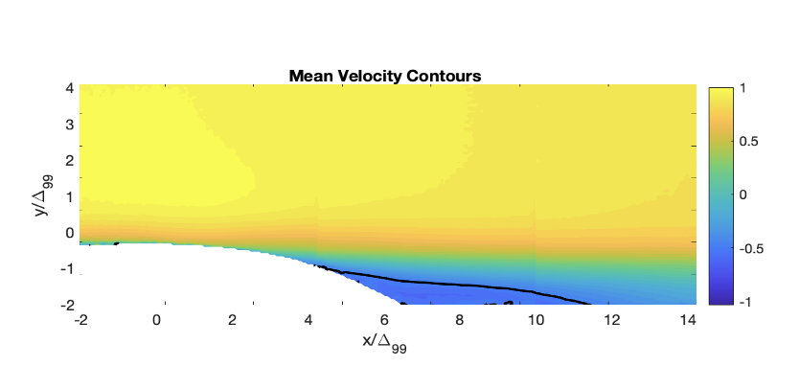
Mean Velocity Contour Comparison
Separation bubble where U = 0
The mean flow behavior roughly remains the same between the fields, but there slightly different observations to be made

Slide 9
Conclusions & Next Steps
Experiments show slight variations in velocity contour plots for porous 3mm plate vs smooth wall
Further investigation such as:
Testing different porosities
Testing different geometries
Testing exotic porosities
Can confirm that the variations in boundary layer separation are due to porosity.
Notes:
Once we understood that the difference
TBL is comprised of stochastic motions and coherent structures with packets of fluids moving independently

Slide 10
The End
Questions?

